Slide 1


Hospital Management System -Yu Yiduo
1306057
CPS 2231 W11 Prof. Wu
2024.05.28
Notes:
Hello everyone, today I am honored to have a presentation about my final project—the hospital management system. And I hope it can be a good project, let‘s go.

Slide 2

CONTENTS
01.Introduction
02.Functions
03.UML
04.Construction idea
05.Test
Notes:
This is the general content of my talk, and I will introduce HMS in five parts

Slide 3

01.Introduction
Frame --- Hospital Management System(HMS) driven
Basic consultation record functions
Save data when HMS excited
Keep all doctor’s consultation history
Notes:
I learned from this course that dealing with the class relationship, data management, and I/O correctly is very important. Additionally, defining exceptions and how to handle them is also essential. That is why I developed this system, because HMS will deal with transaction exceptions and store and search data also through exceptions, and these exceptions are a good example to throw it and let the caller handle it. Doctors, patients, and hospitals' definition of the class relationship is also a challenge in this project, and it helped me better understand OOP concepts. HMS drives this system and, at the same time, achieves some essential functions; it can register, log in, complete identity verification, and save each doctor's information, essential diagnosis records, and history records.

Slide 4
02.Functions
Register
Log in
Doctors register their own accounts
The doctor enters his ID and password to log in to the account
R
L
Consultation
Bill
B
C
The doctor records the patient's condition by asking for basic information about the patient to complete the diagnosis
Patients pay medical bills
Notes:
So, here is a summary of the hospital management system, the four main functions are register, log in, consultation, and bill.

Slide 5
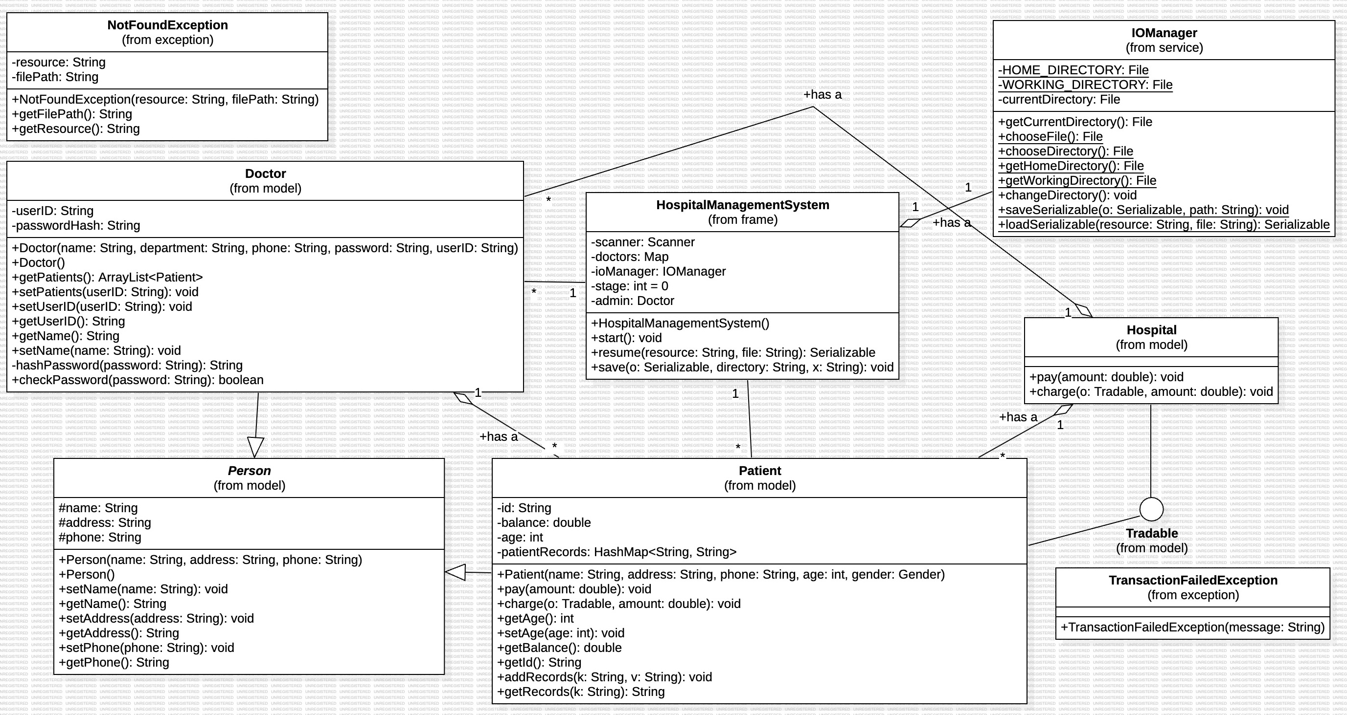
03.UML
Notes:
The person class is an abstract class, and the doctor and patient are extending the person class. Hospital and patient classes implemented Tradable because I want to use a tradable interface as our parameters in the transfer method, so they must implement the pay and charge. Our IO operations are implemented by the IOManager class. IOManager implemented a general save that is serializable and not serializable. Next, I want to introduce IO.

Slide 6
04. Construction Idea
Name: ./tmp/admin(Binary I/O) to read and store
Name: ./tmp/doctors(Binary I/O) to read and store
Object input stream:
Doctor
Doctor: Admin---who use the HMS(Input and Output)
./tmp/system.txt
Hospital
HMS
Doctors
Patient
Medical record
Object output stream:
File Name: ./tmp/patient (Binary I/O) to read and store
File Name: ./desktop/records/patients.txt –to check
Notes:
This blue arrow is the object output stream, and the yellow arrow is the object input stream. The doctor is admin retrieve from doctors. When the user registers successfully, his information will be stored in the doctors and doctors arraylist. When a user logs in successfully, we will make an admin; then, the user excites the HMS. Reopen, we can use admin to process again and use the admin to process any operations. Doctors can use HMS to consult with patients and record information in the medical records. The patient is using it for transfer to the hospital.

Slide 7
PART five
Test
Notes:
Next I'll show some basic features

